Slide 1
REACH antenna meeting - Figures of merit - Dual ridged horn
Nicolas Fagnoni – 26/08/2019
nf323@mrao.cam.ac.uk – University of Cambridge – Astrophysics Group

Slide 2
Summary
1. Design presentation
2. Performance without ground plane
3. Performance with TOP ground plane
4. Performance with BOTTOM ground plane
5. Summary
6. Conclusion

Slide 3
Design presentation

Slide 4
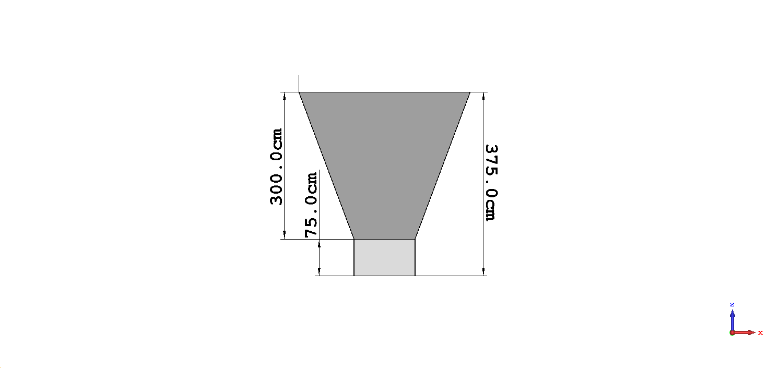
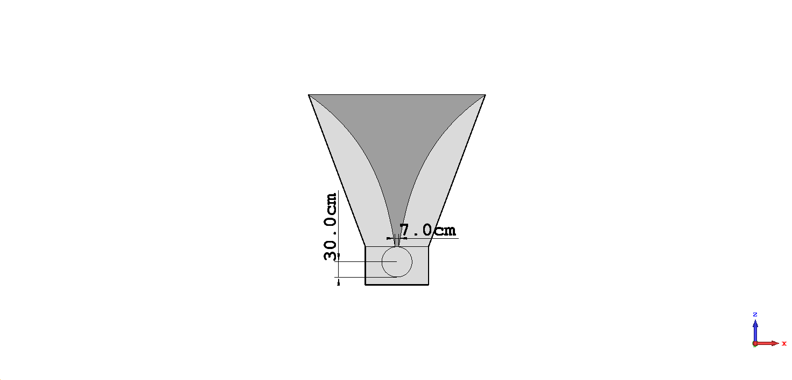
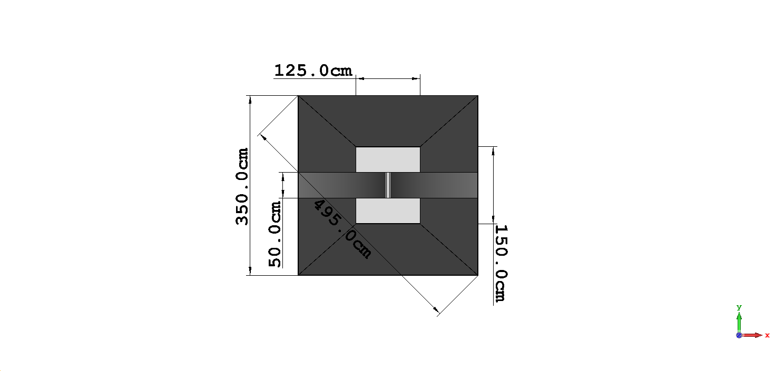
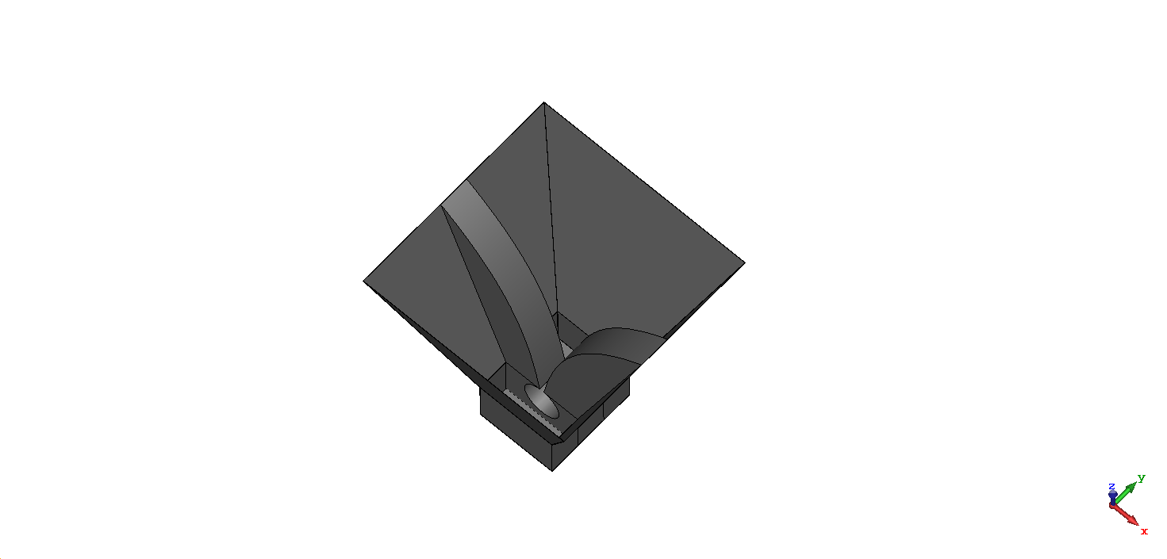
Dual ridged horn dimensions

Slide 5
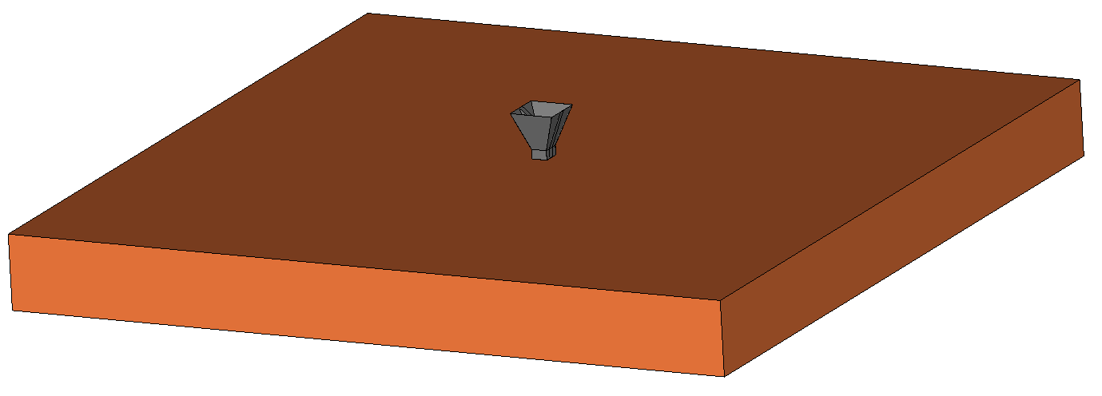
Soil parameters
Sandy dry soil
ε_{r} = 2.5
tan 𝛿 = 0.016
Dimensions
60 x 60 x 6 m
Simulation parameters
Time solver
T_{max} = 500 ns

Slide 6
Performance without ground plane

Slide 7
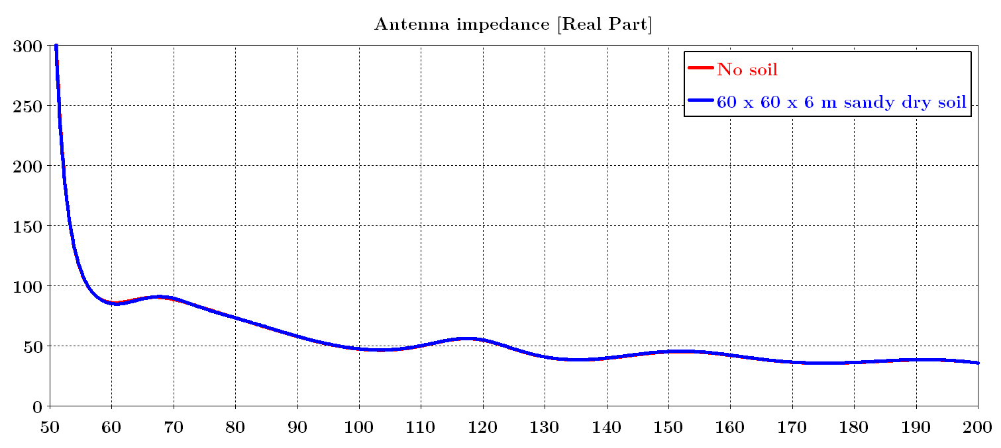
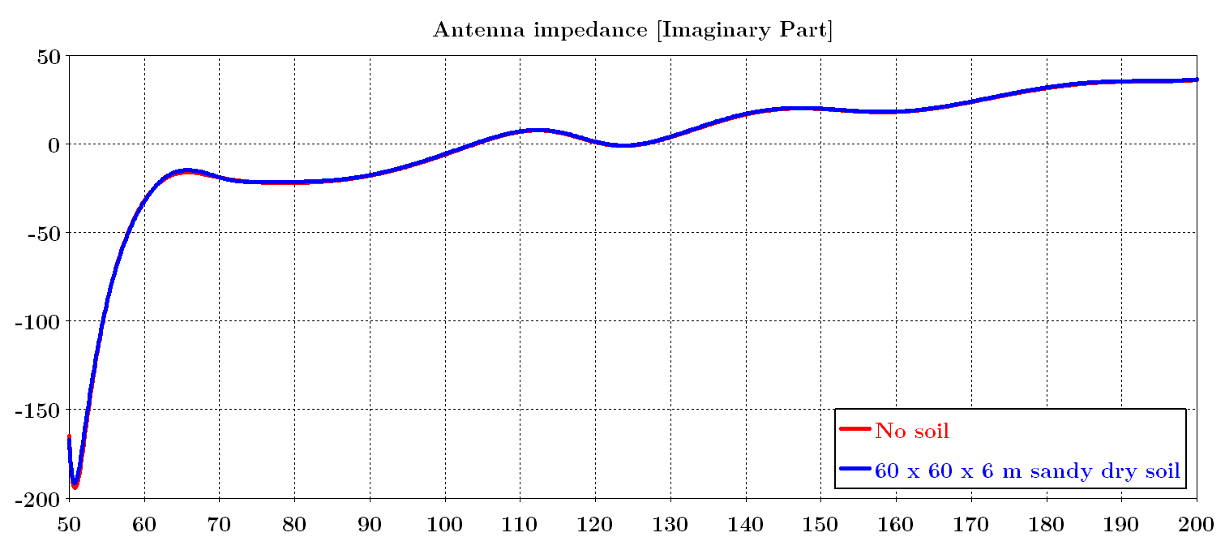
Antenna impedance

Slide 8
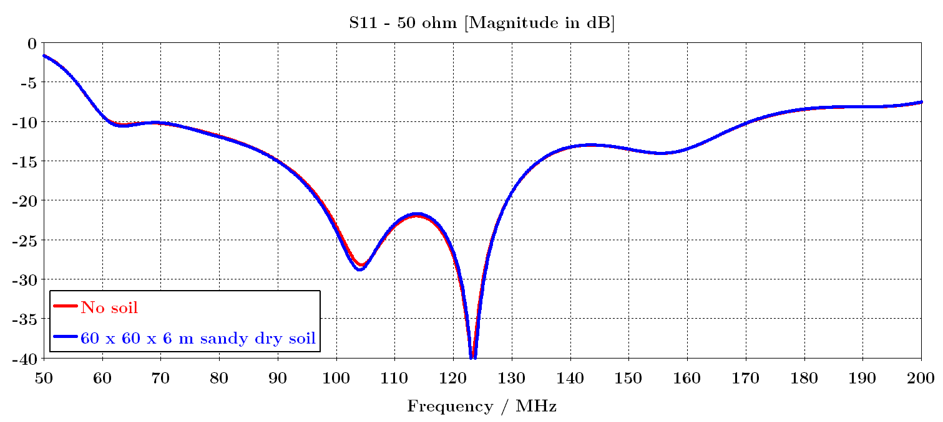
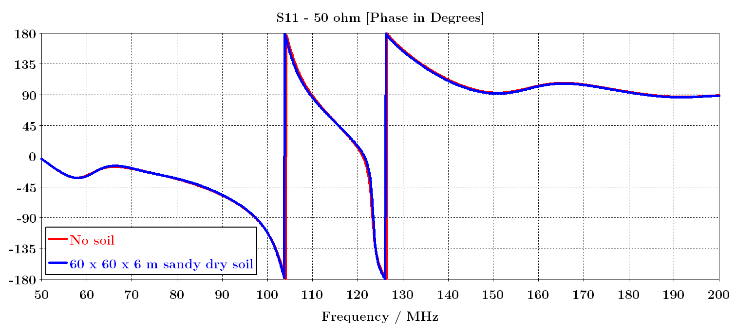
S11 – with respect to 50 ohm differential

Slide 9
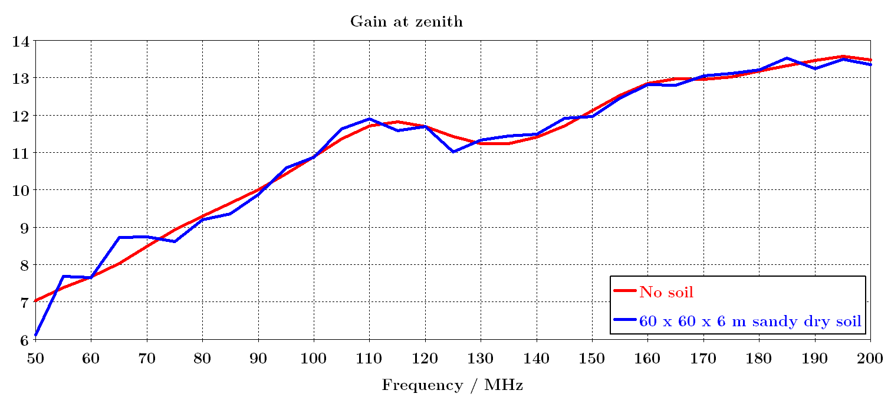
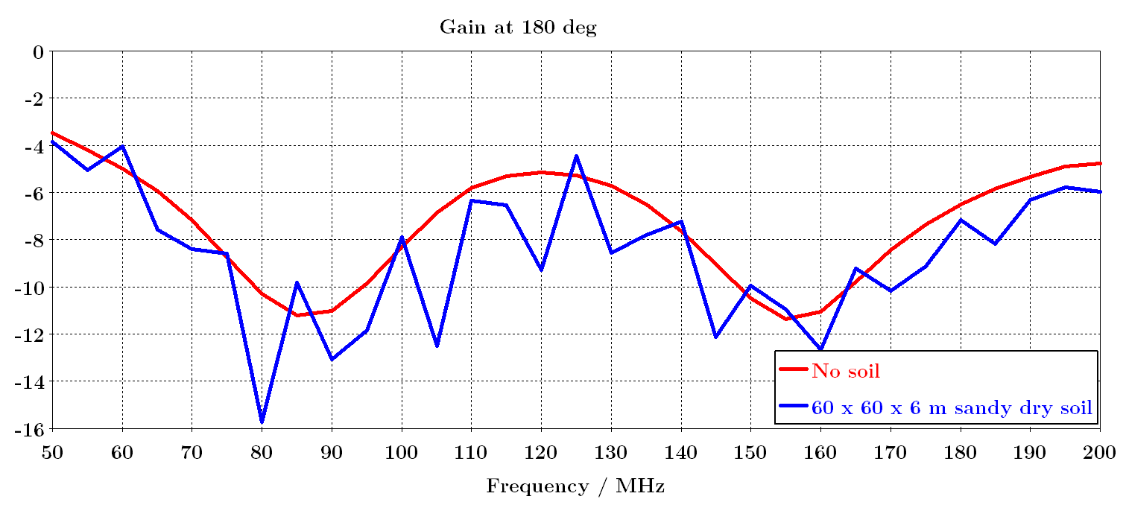
Gain (dB) at zenith and at 180°

Slide 10
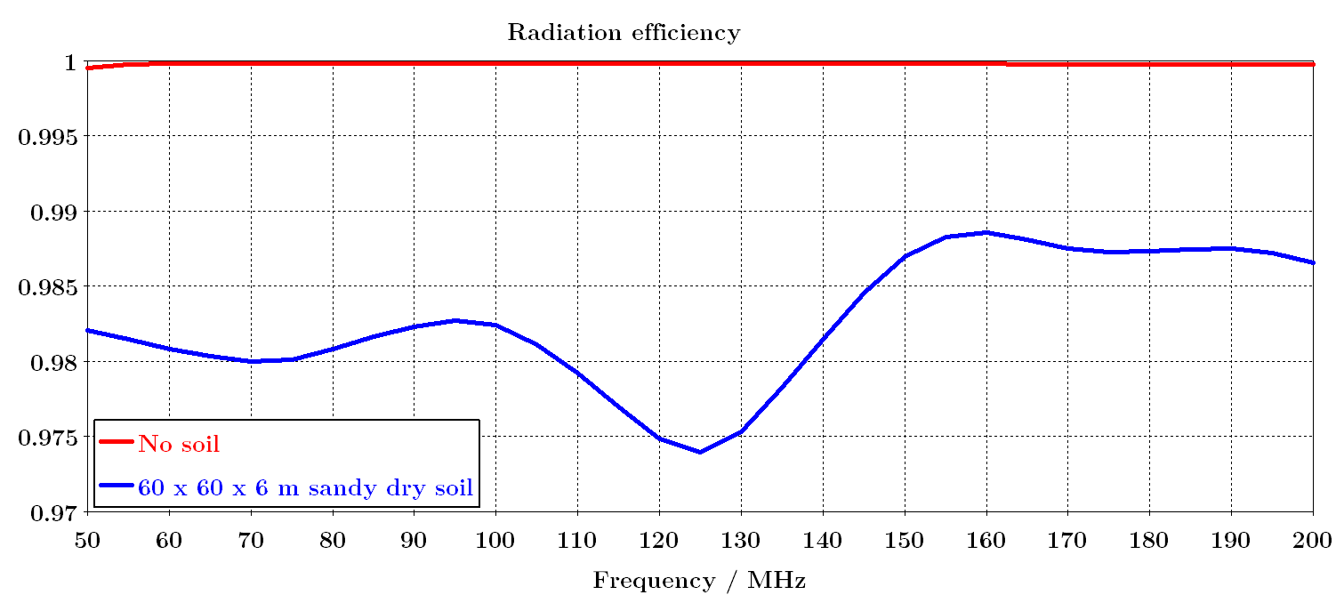
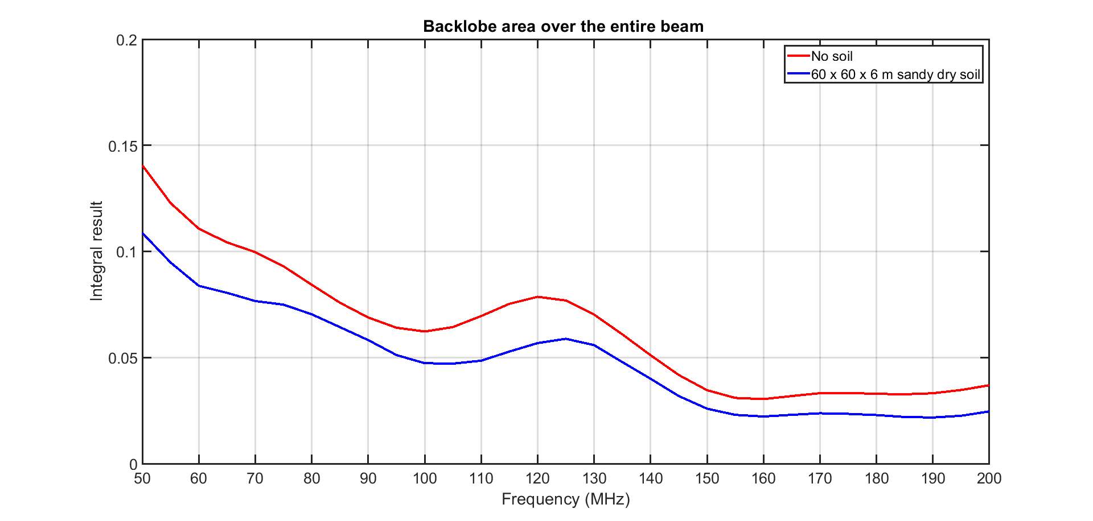
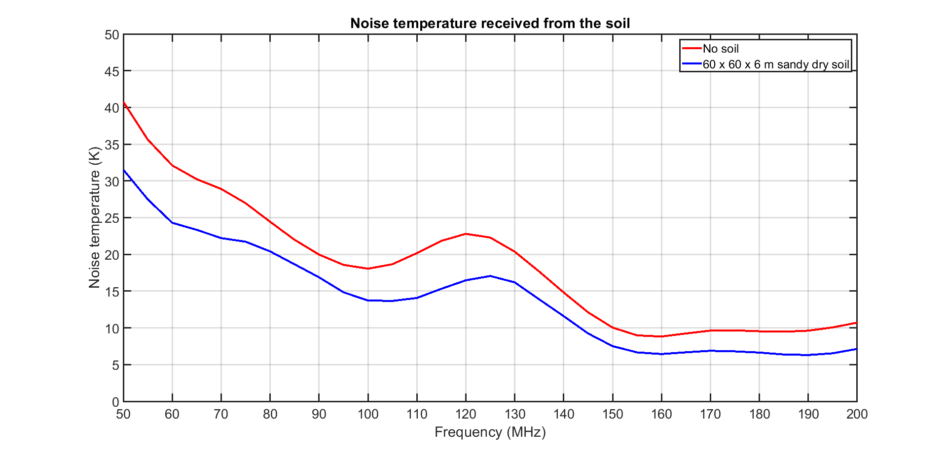
Radiation efficiency and backlobe area
Tsoil = 290 K

Slide 11
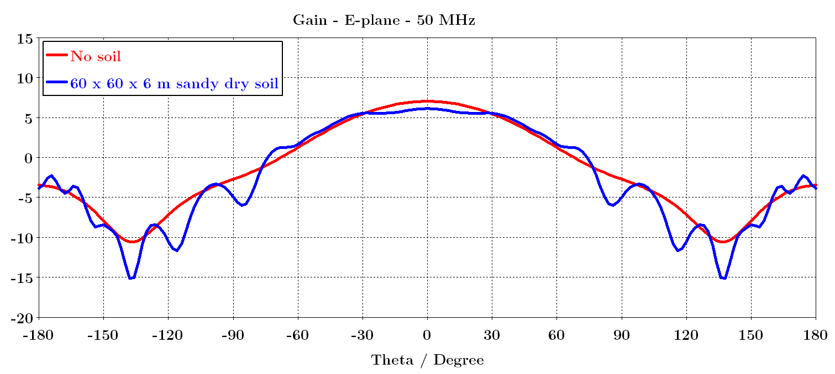
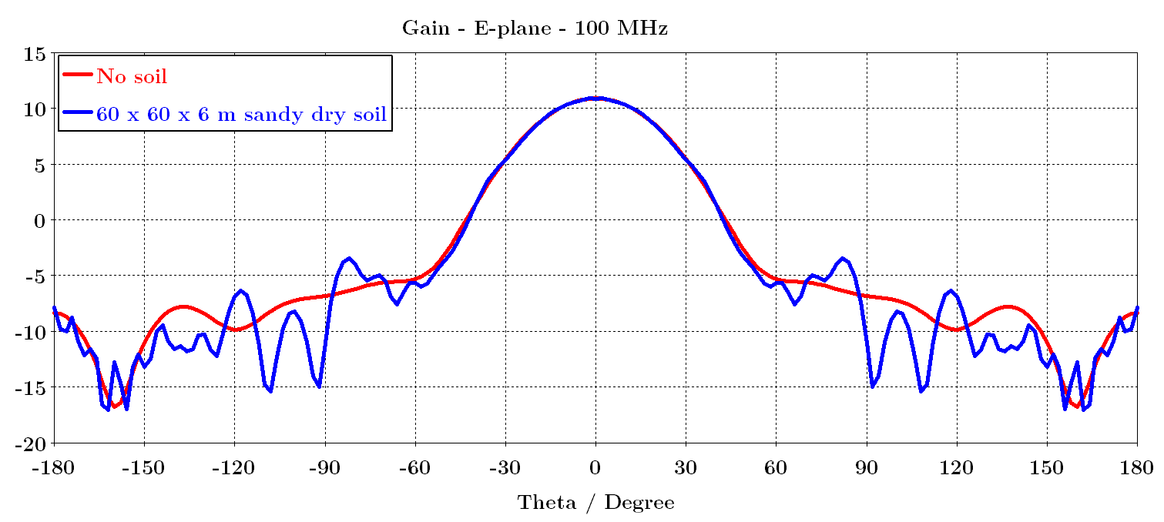
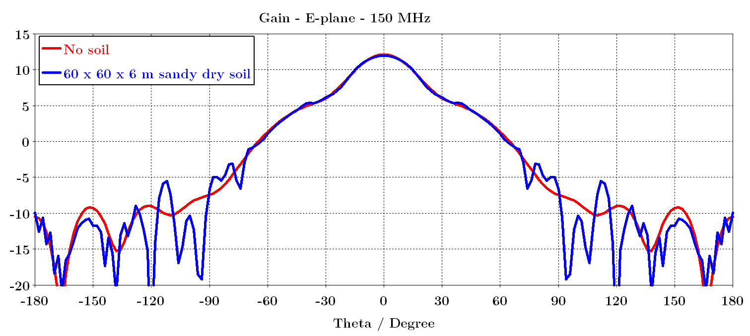
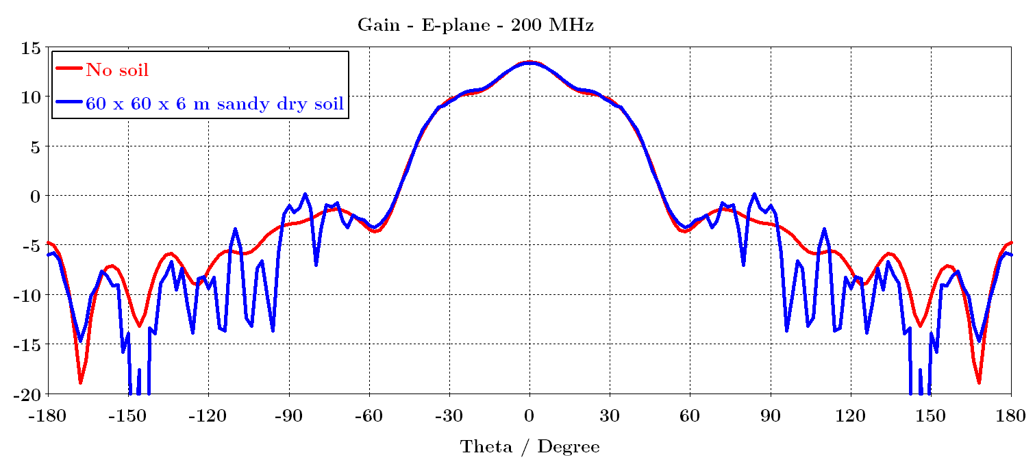
Gain patterns – E-plane

Slide 12
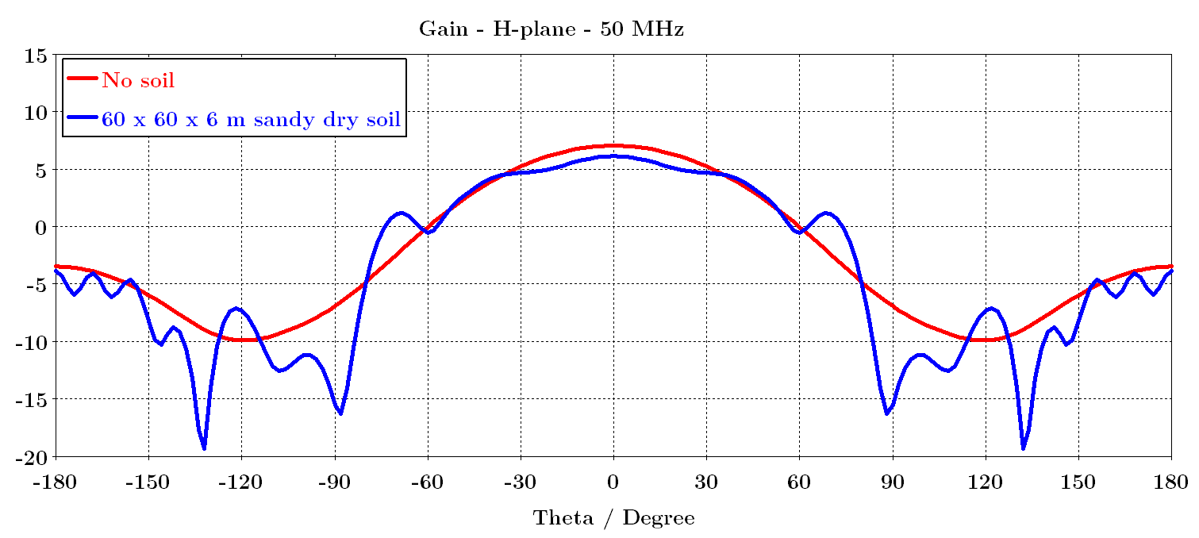
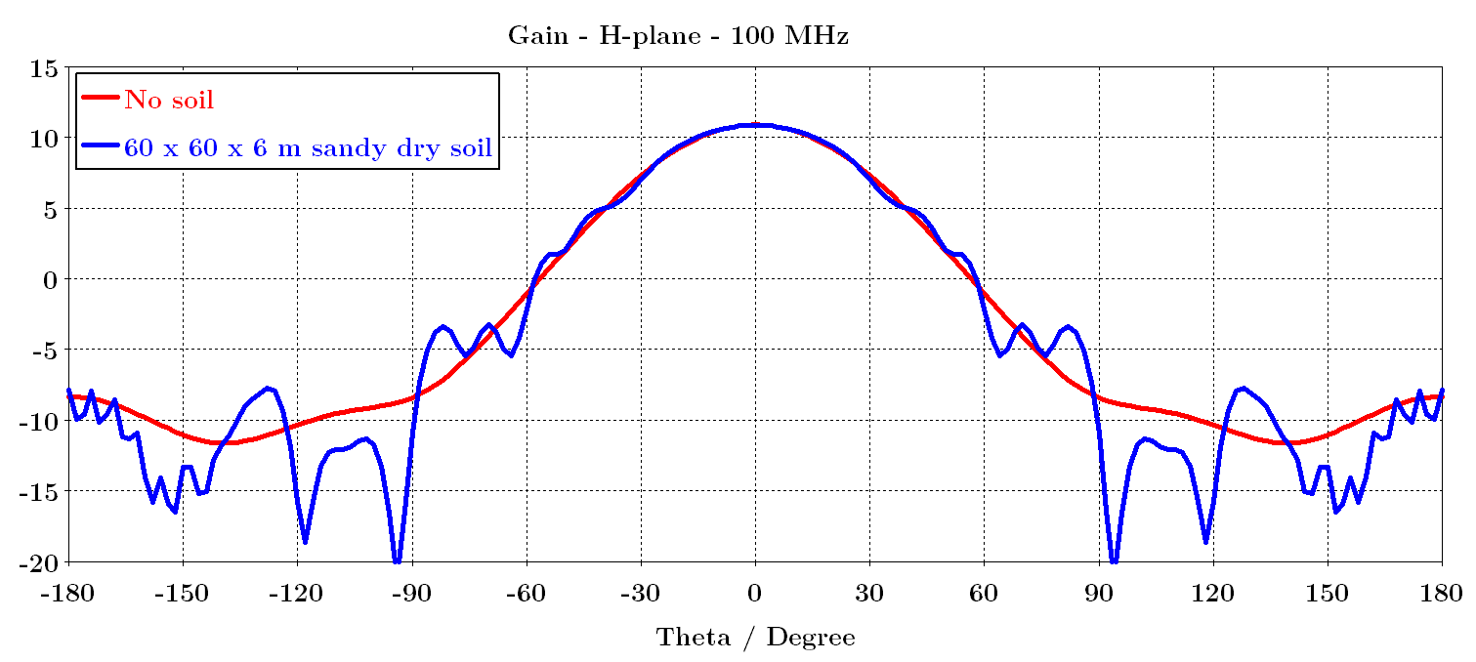
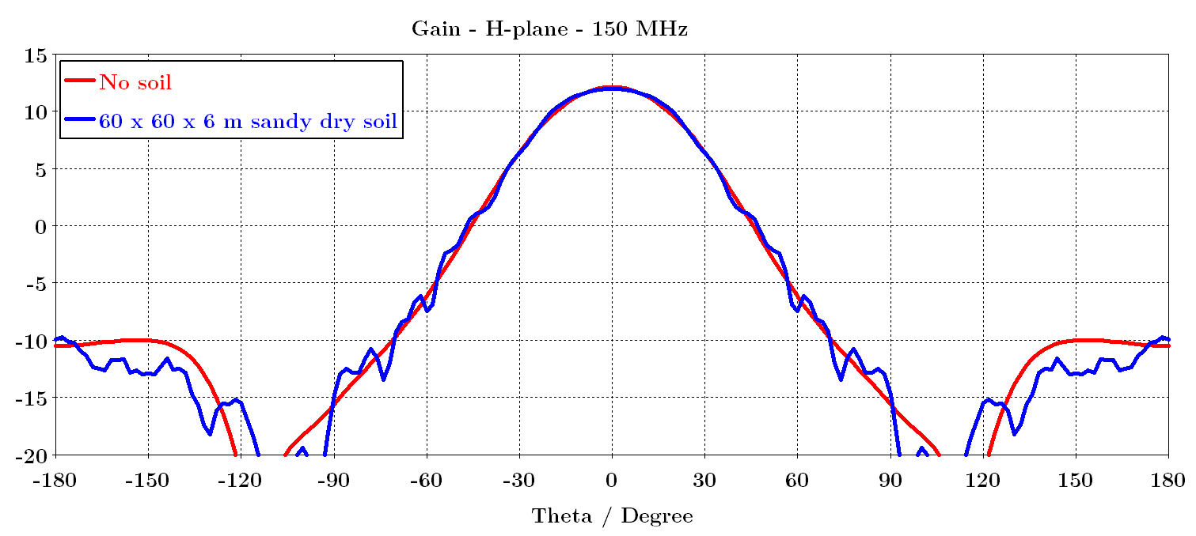
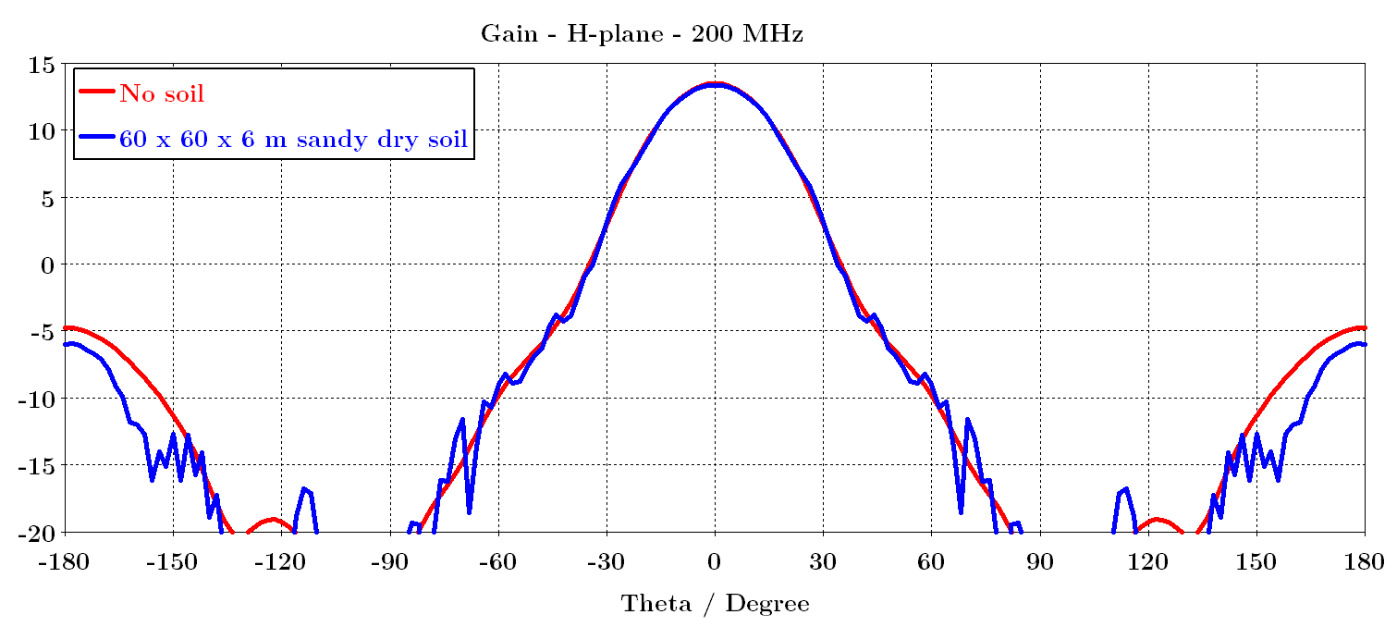
Gain patterns – H-plane

Slide 13
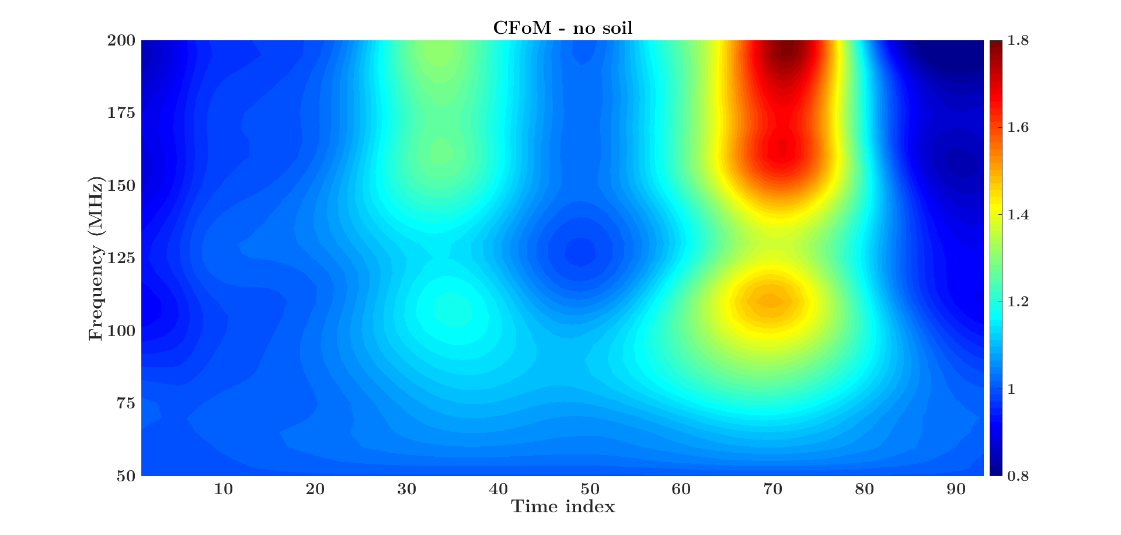
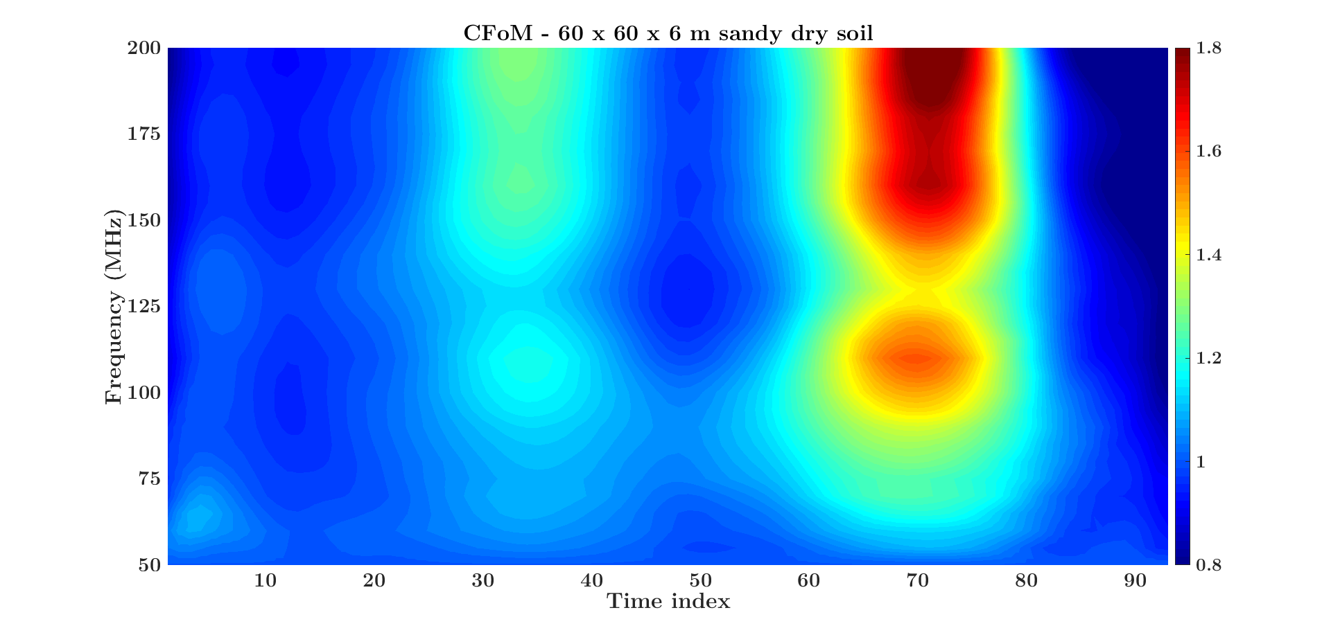
Chromaticity

Slide 14
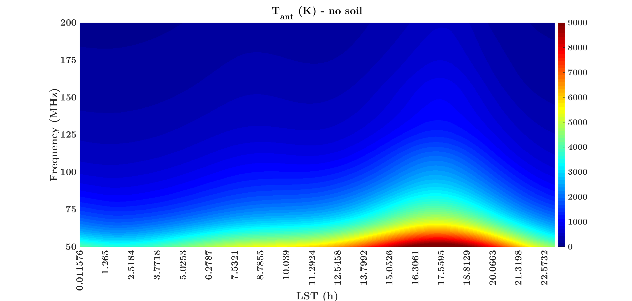
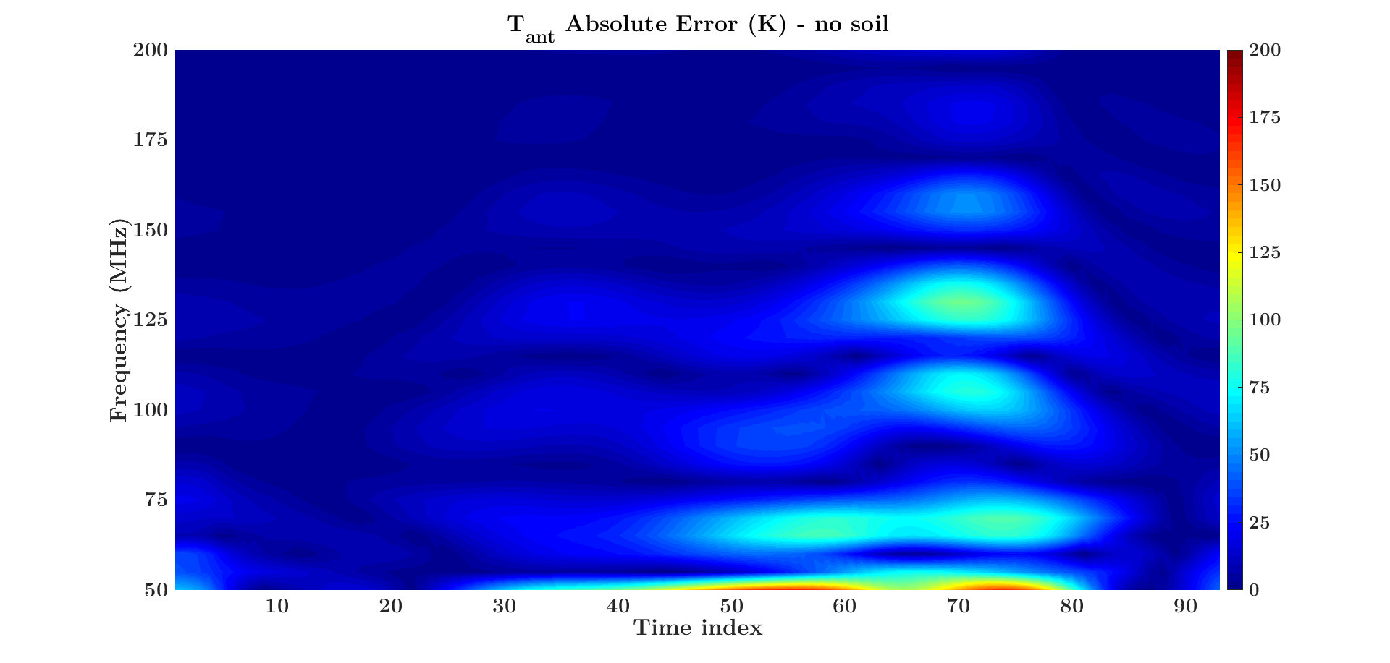
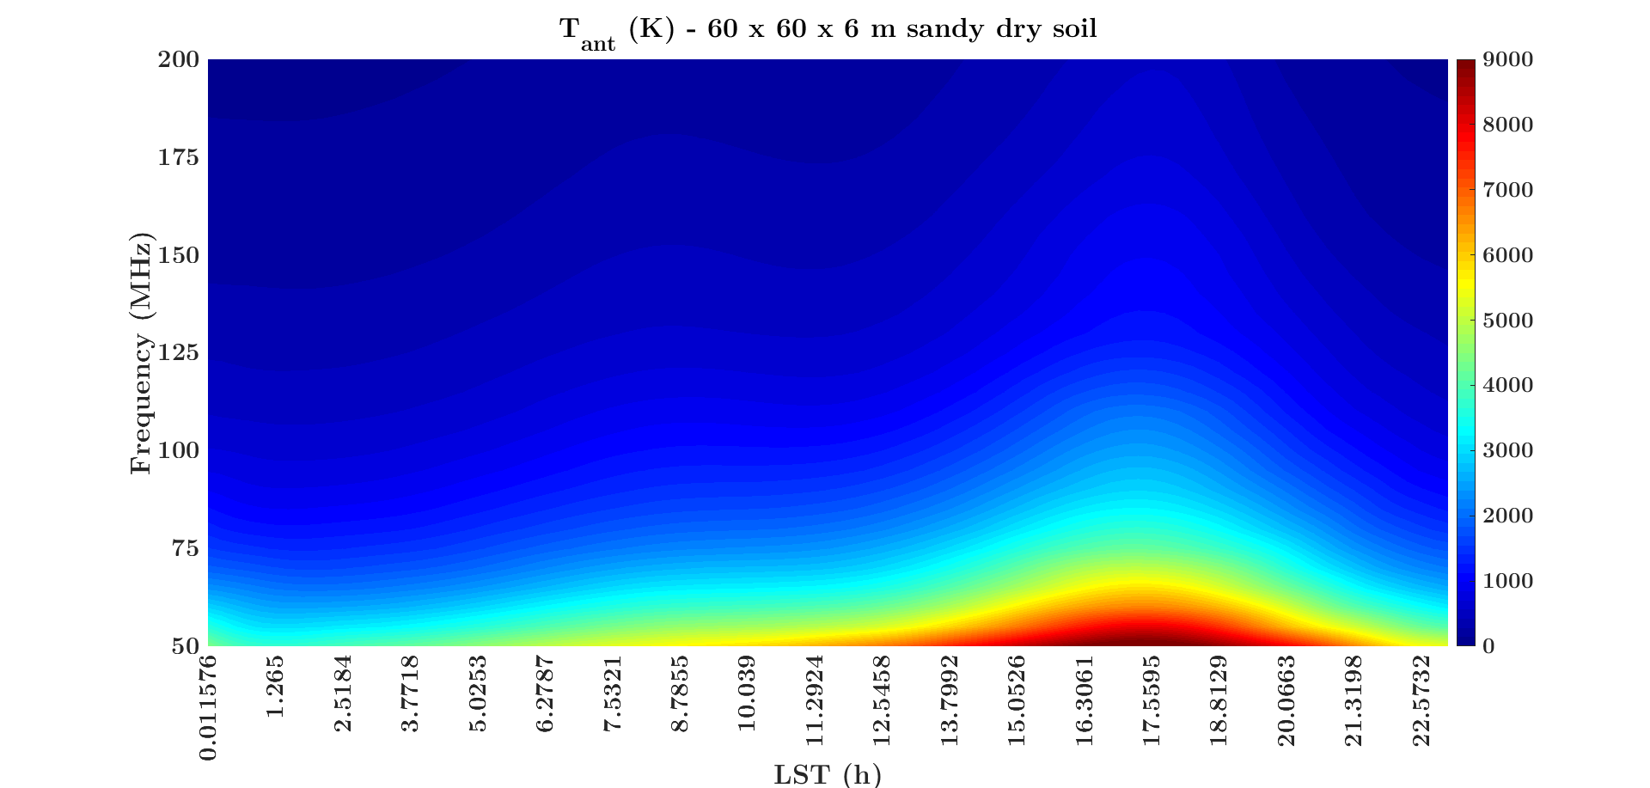
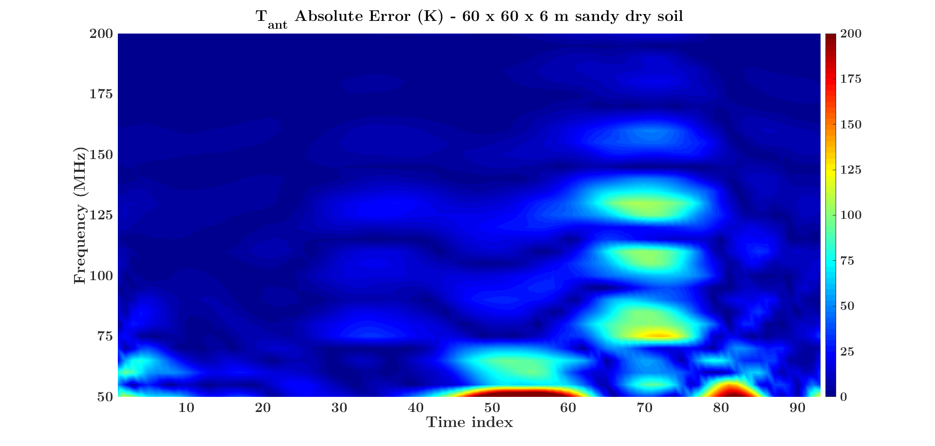
Antenna temperature with sky model

Slide 15
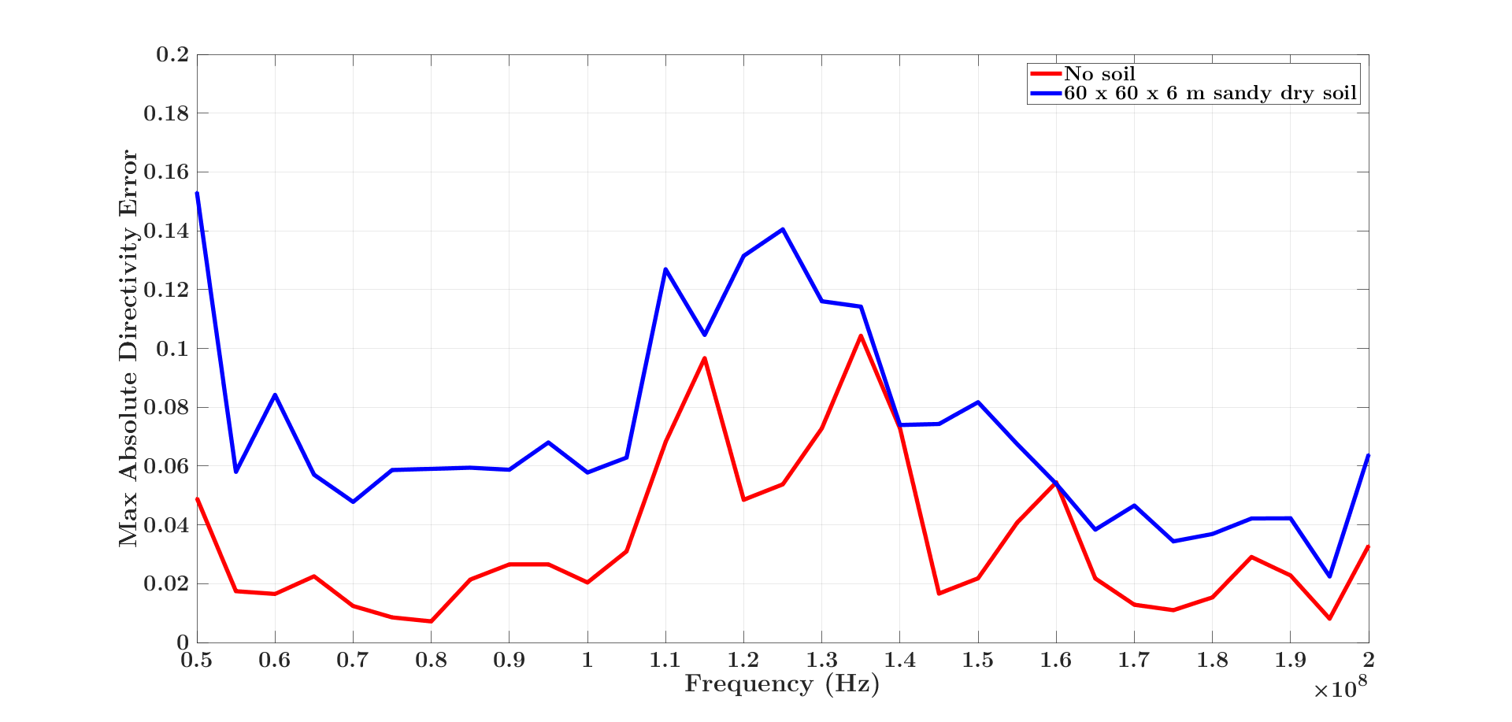
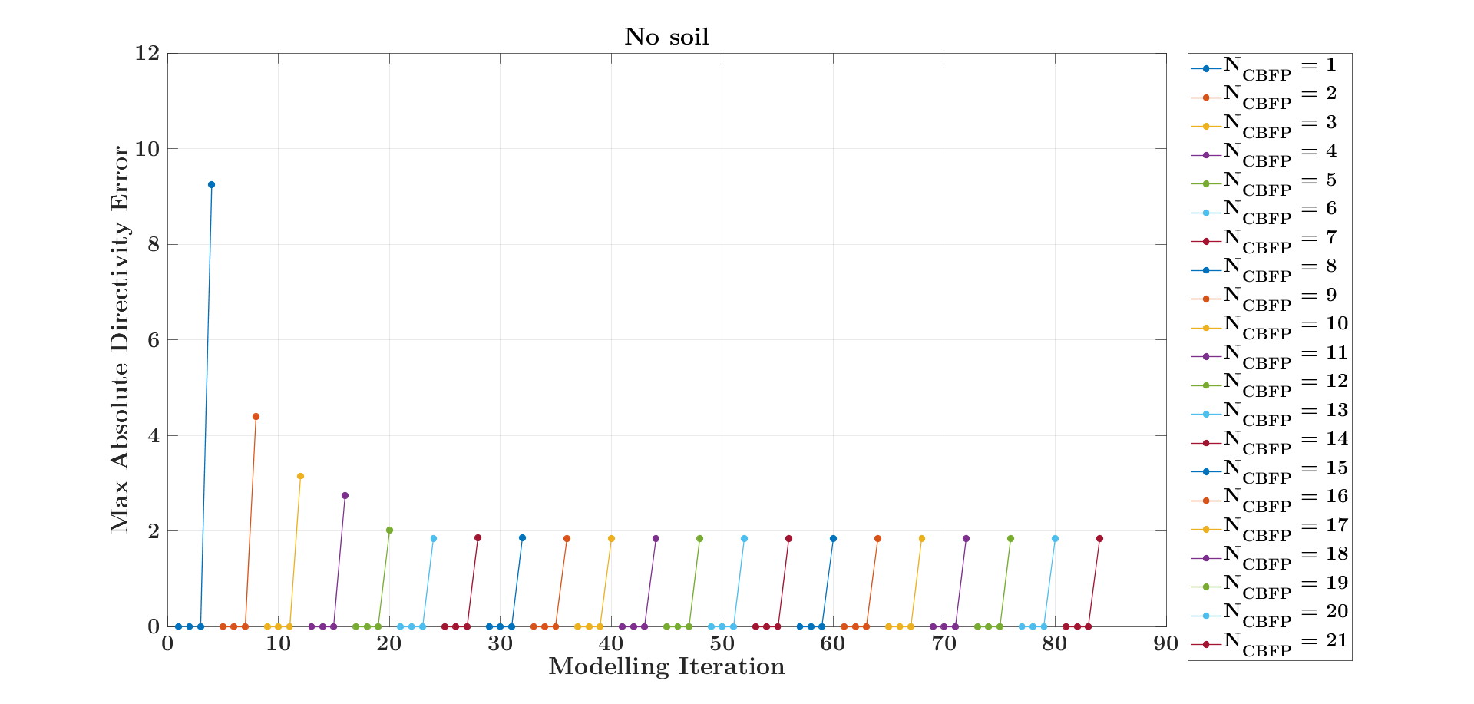
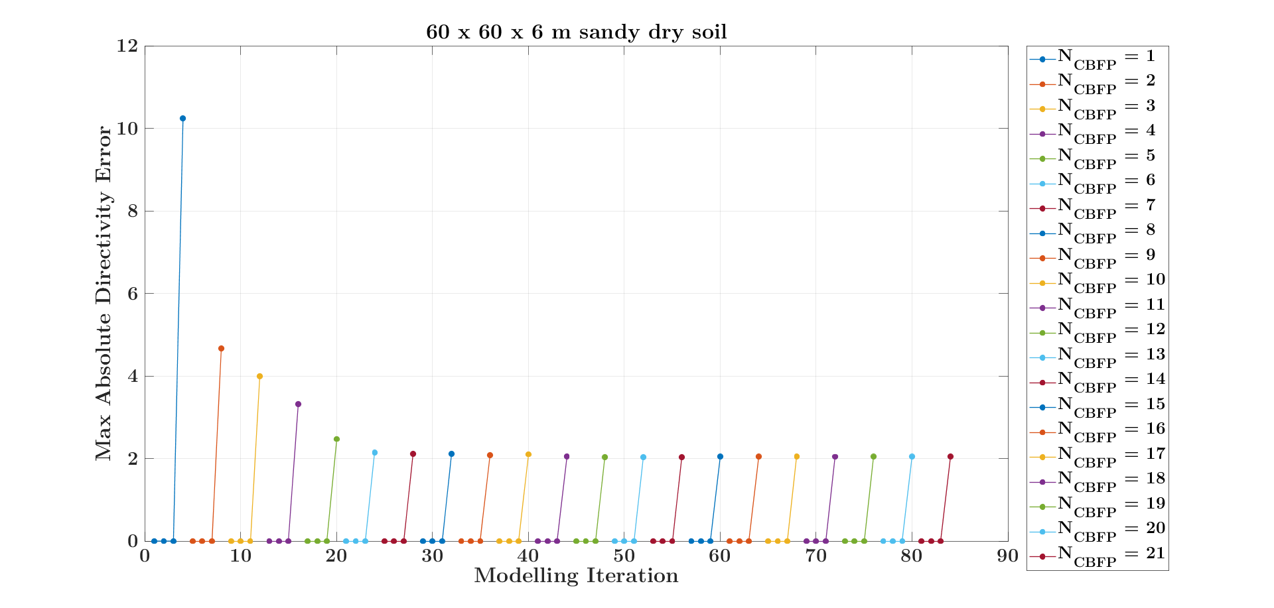
Max absolute directivity error

Slide 16
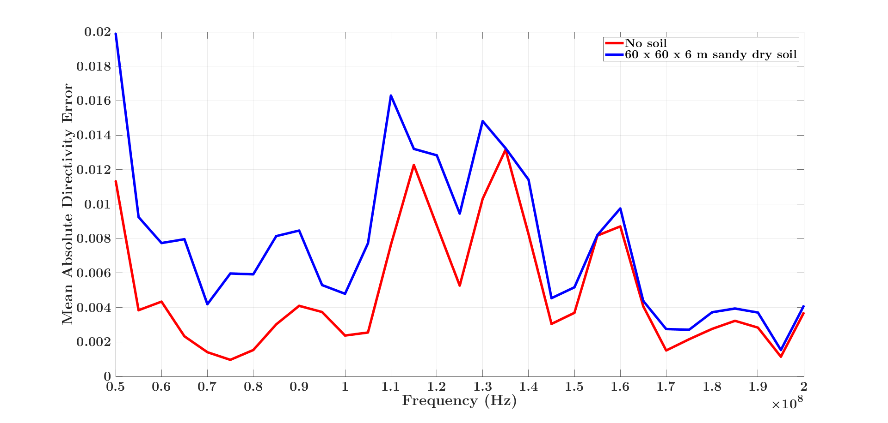
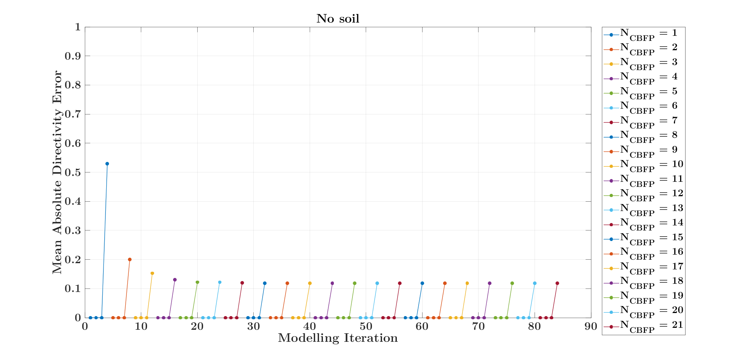
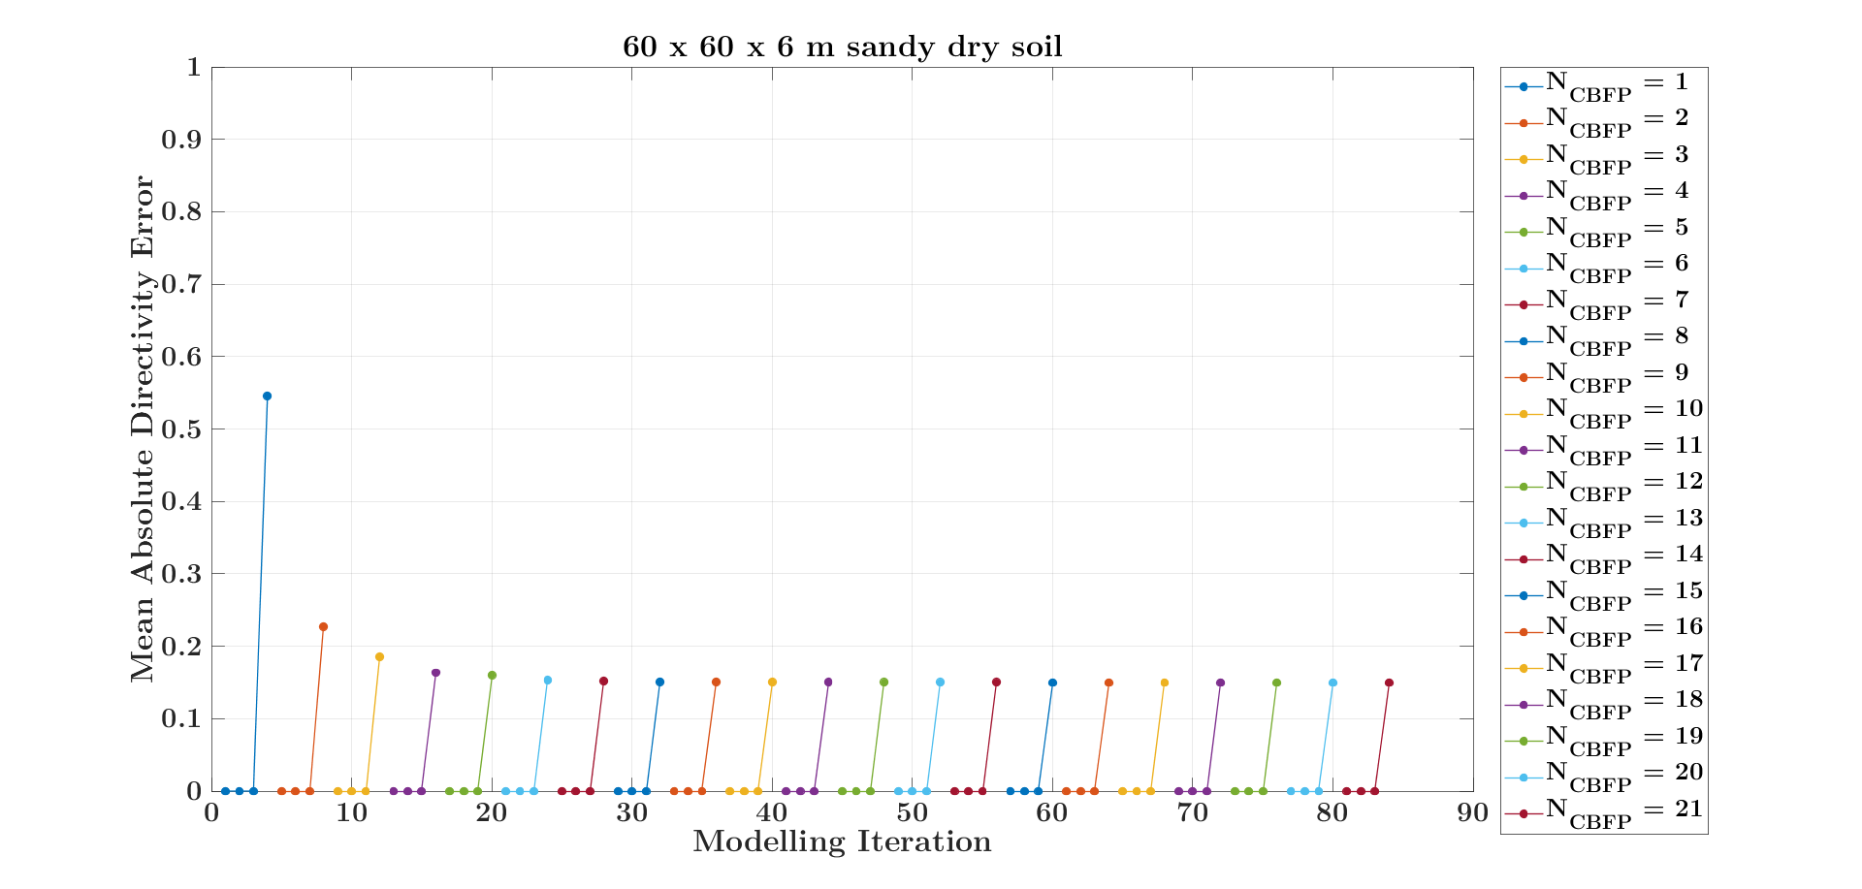
Mean absolute directivity error

Slide 17
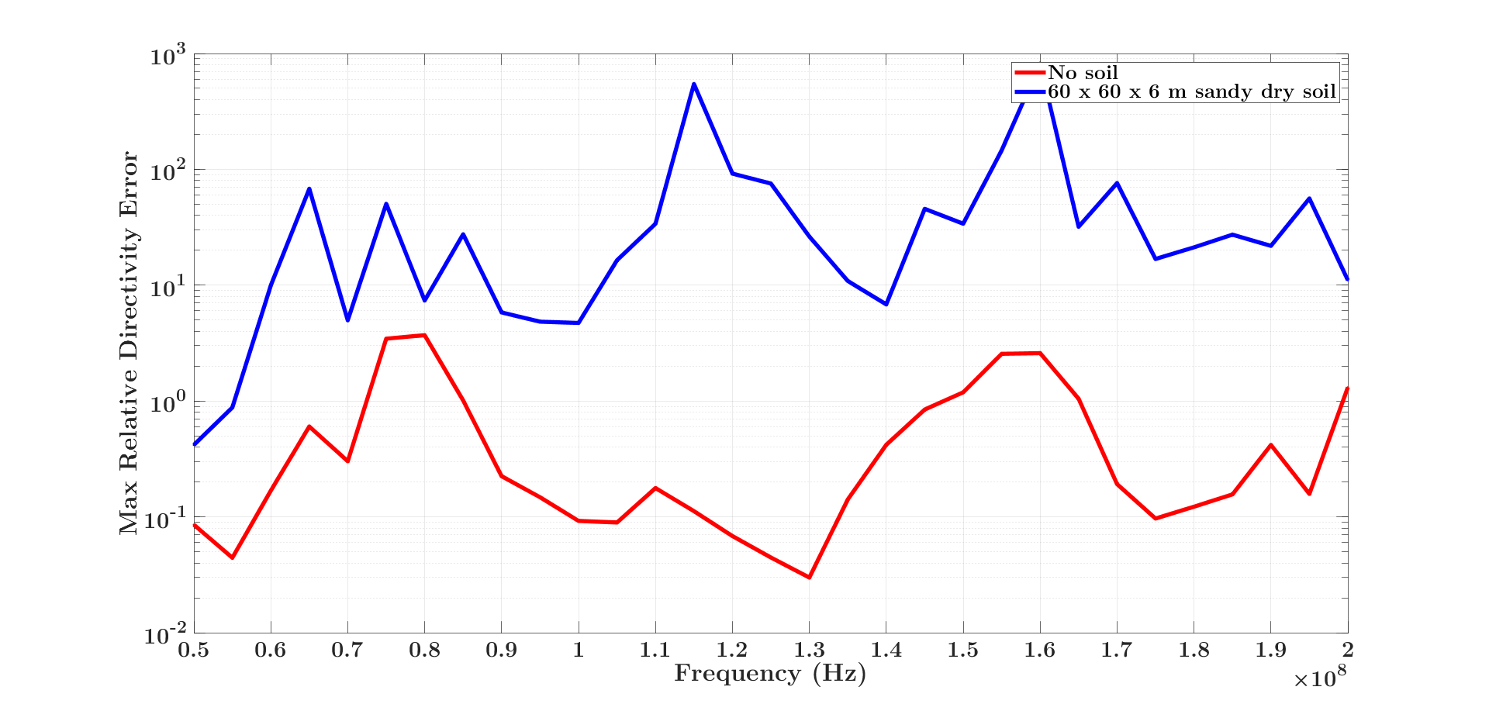
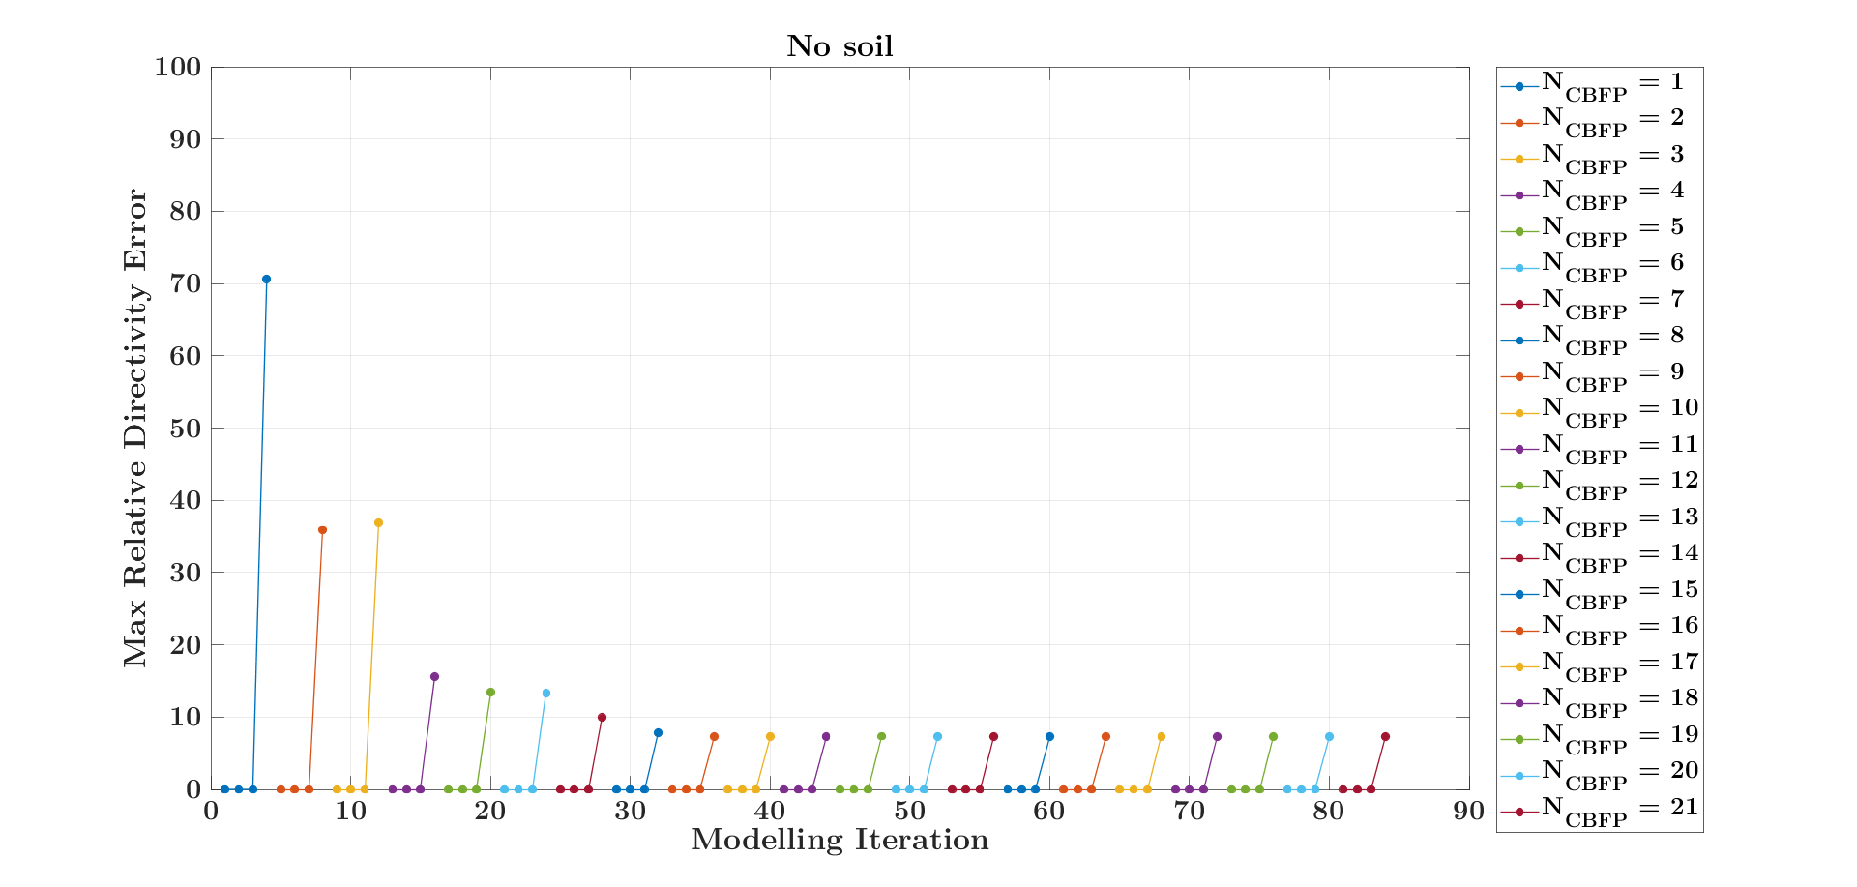
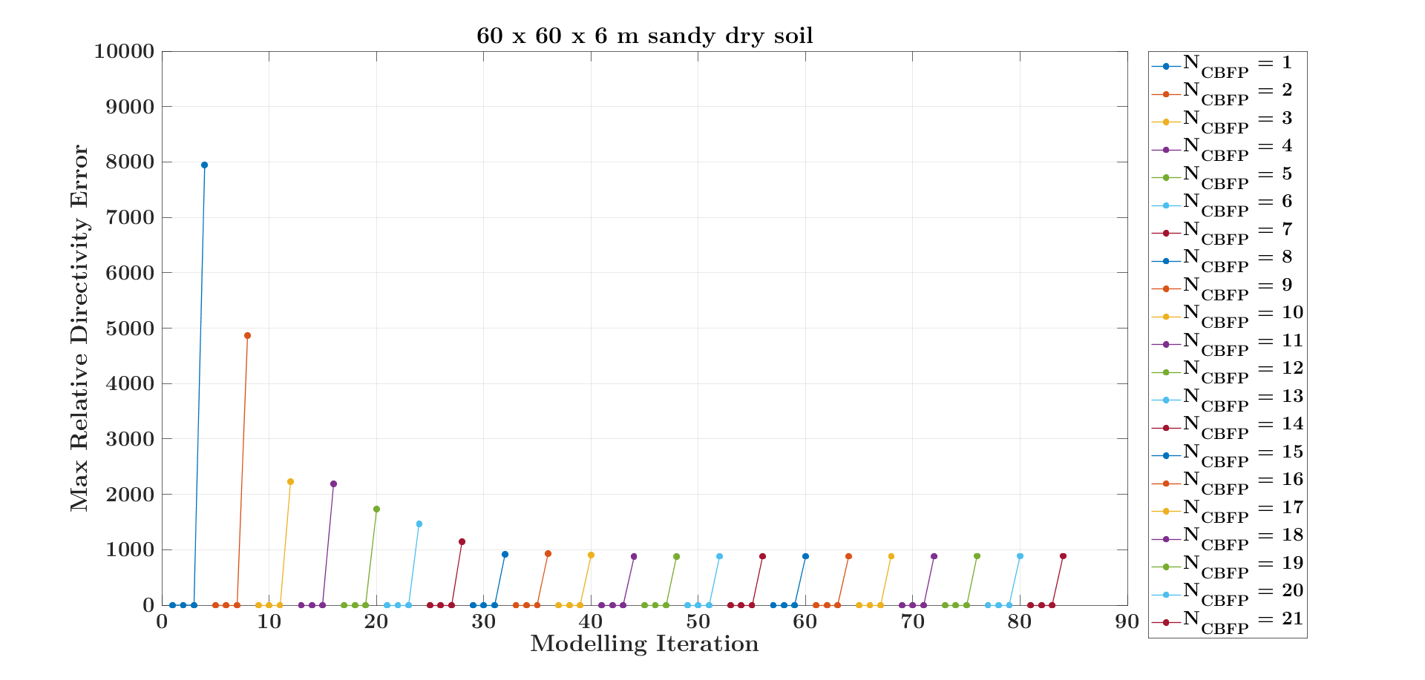
Max relative directivity error

Slide 18
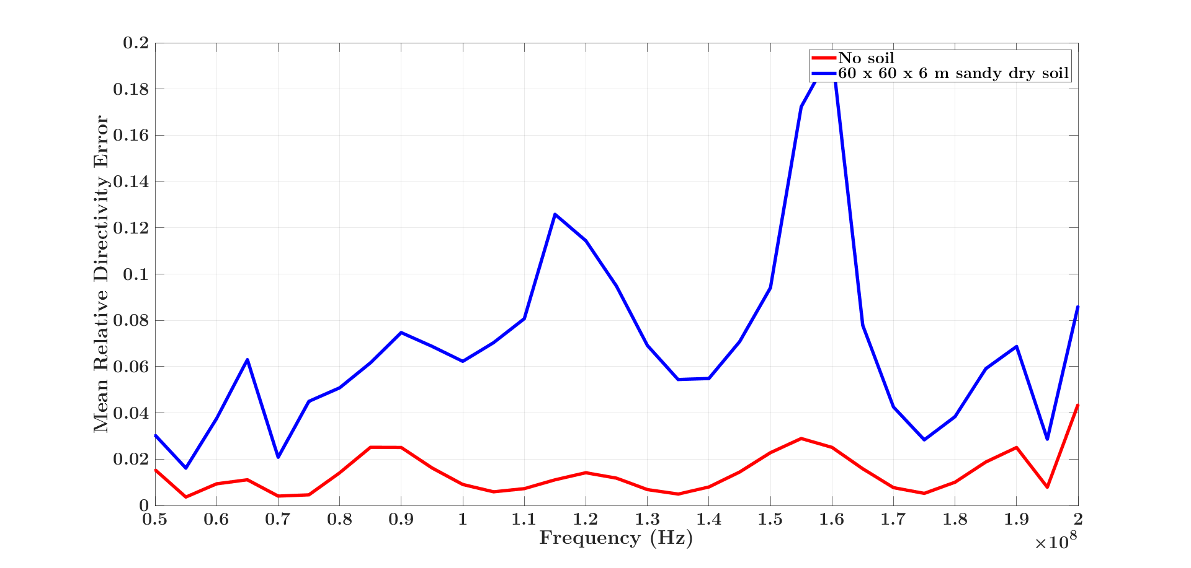
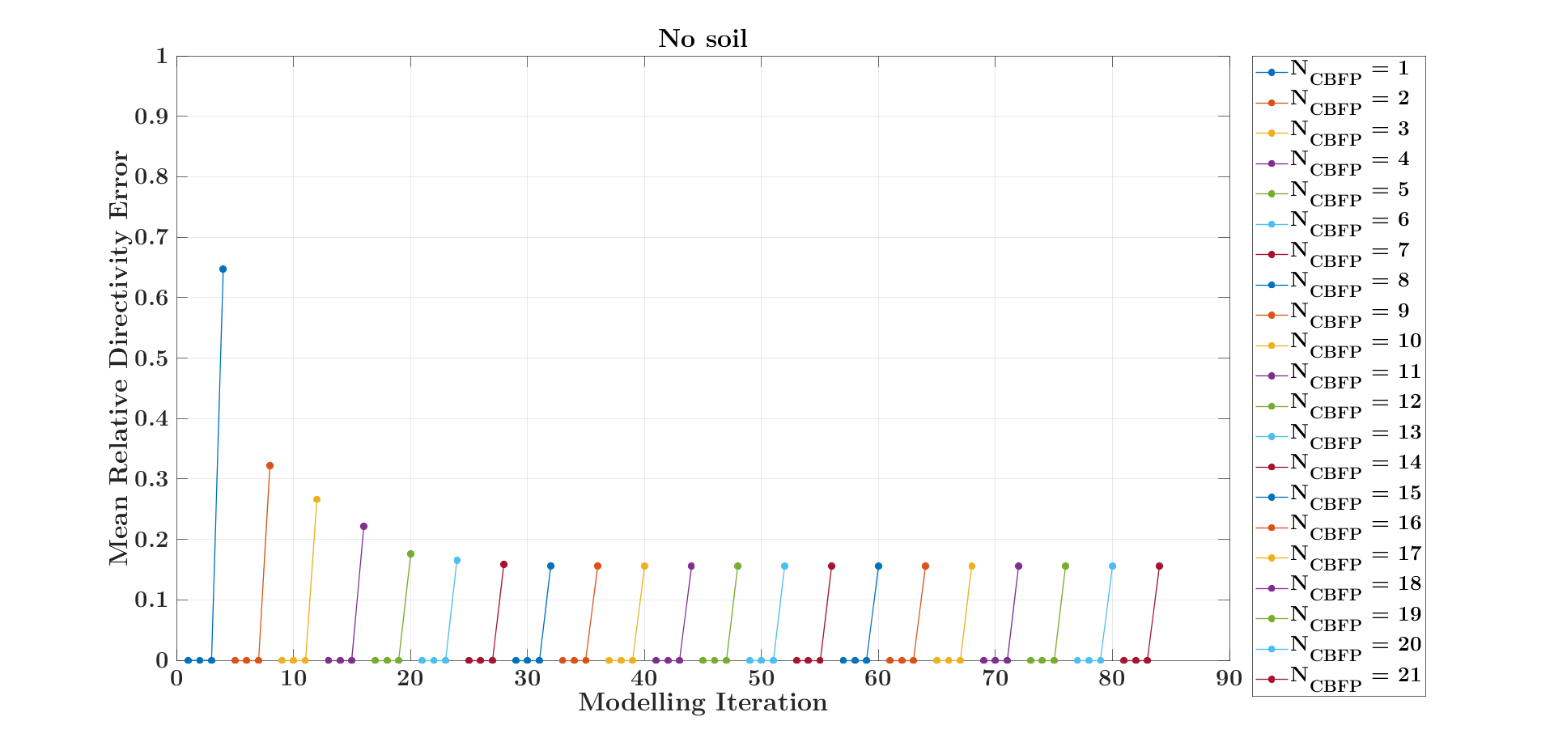
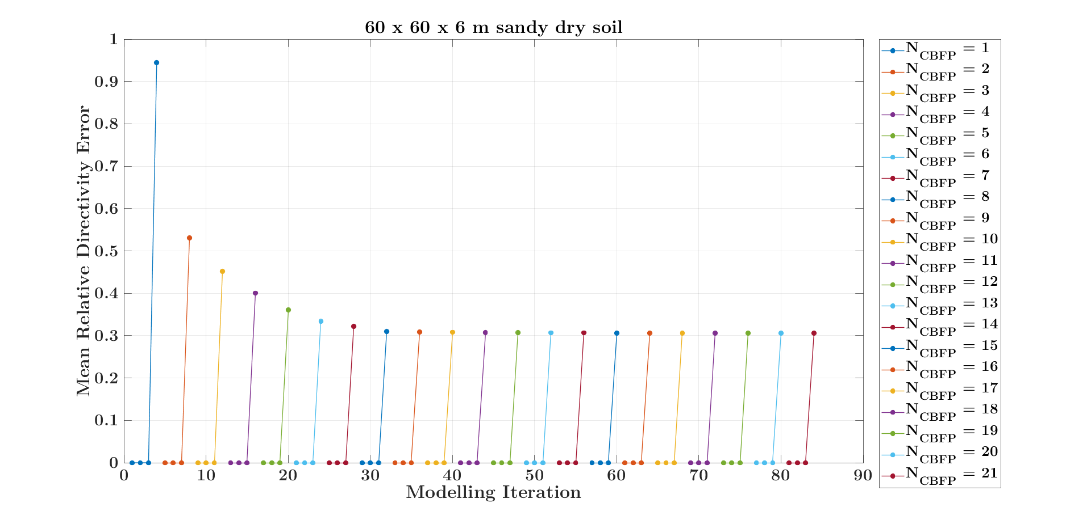
Mean relative directivity error

Slide 19
Performance with TOP ground plane

Slide 20
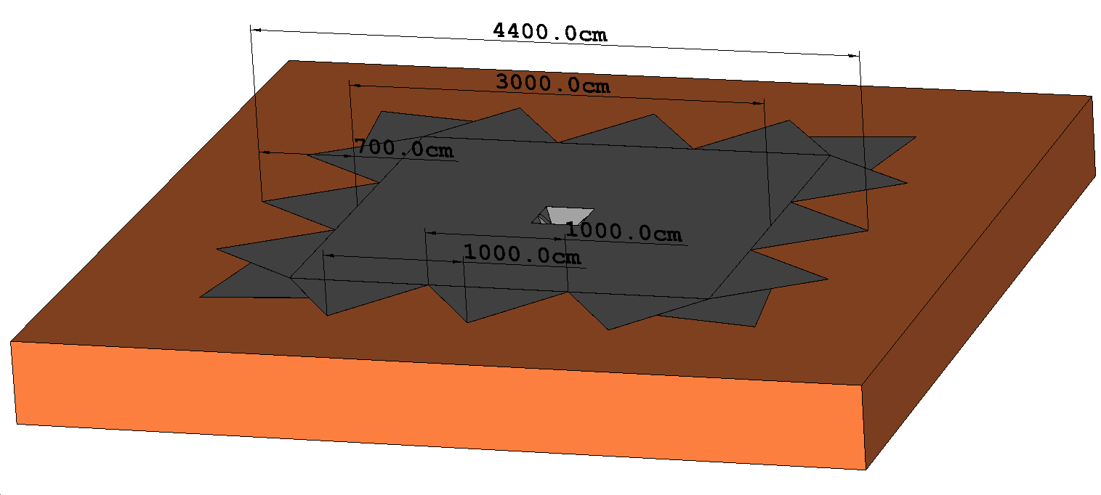
Serrated top ground plane

Slide 21
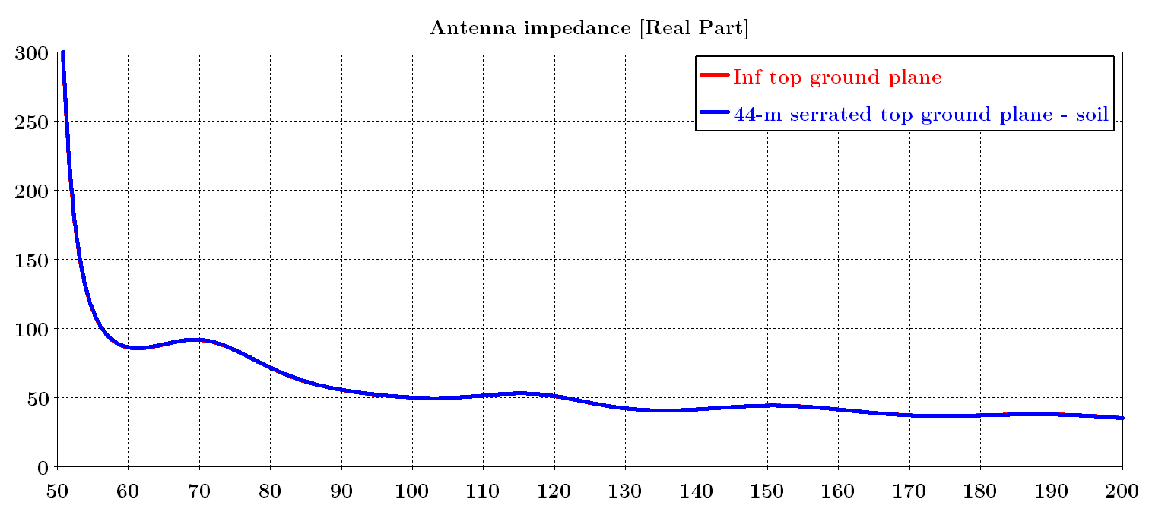
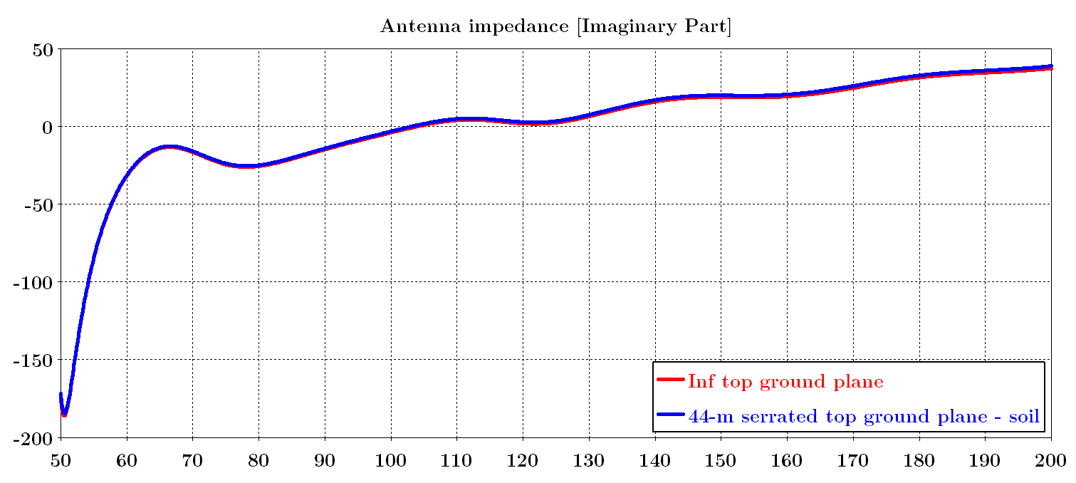
Antenna impedance

Slide 22
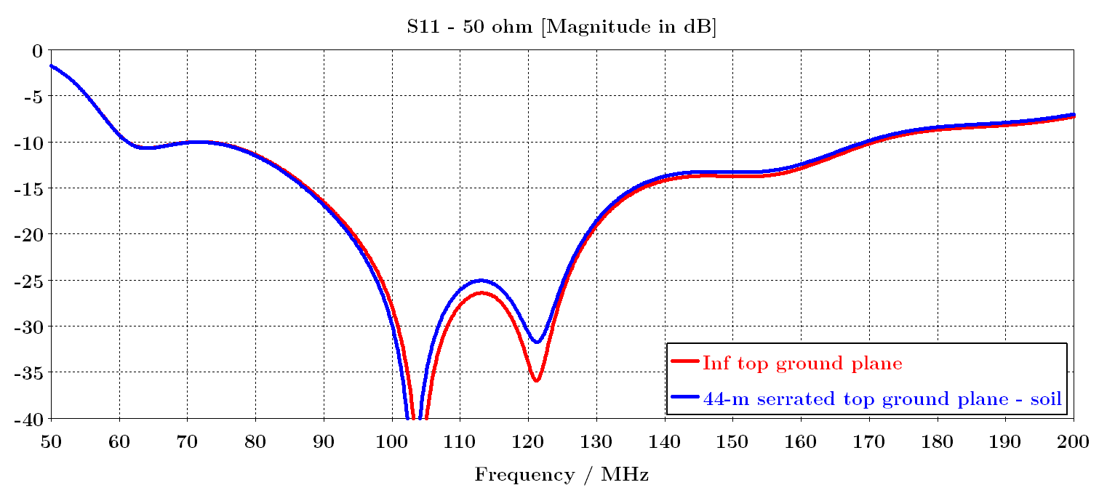
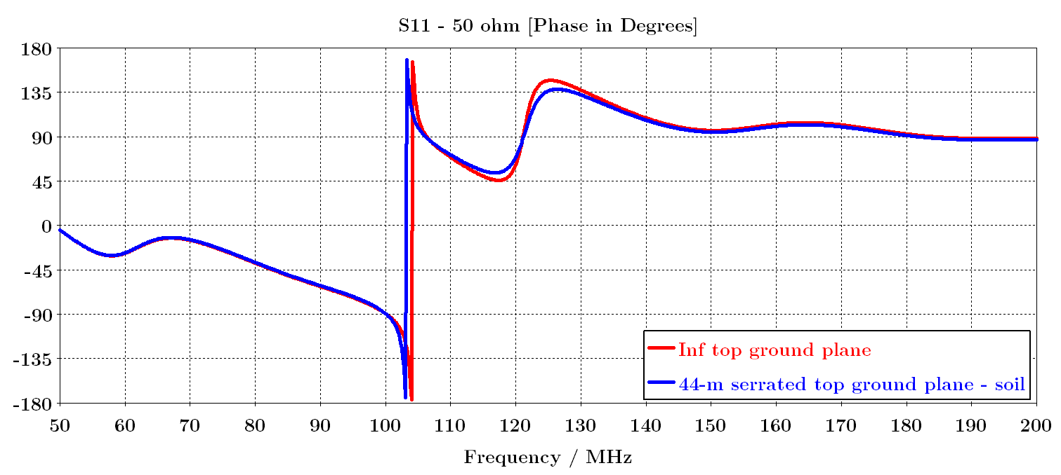
S11 – with respect to 50 ohm differential

Slide 23
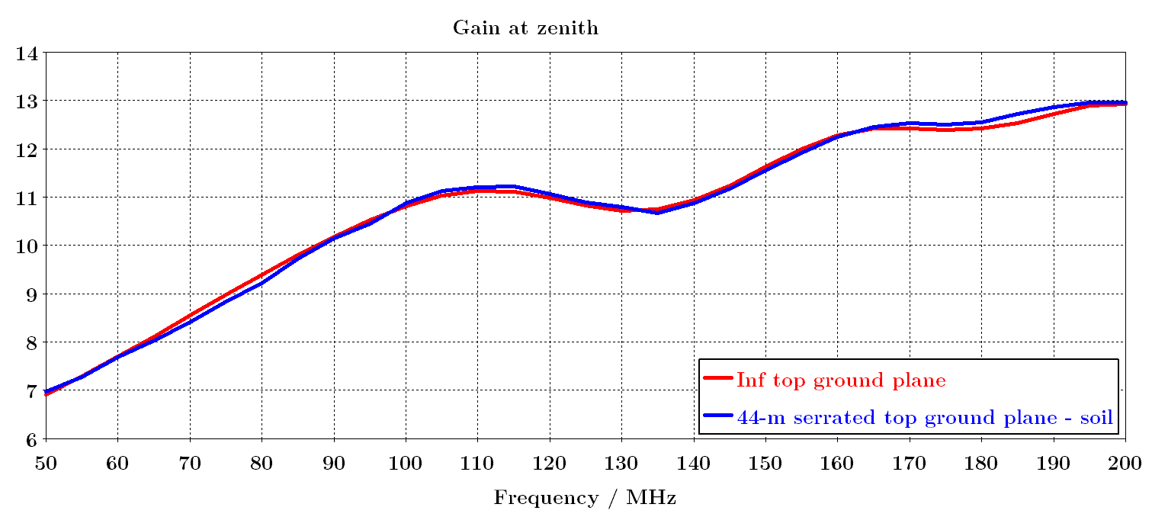
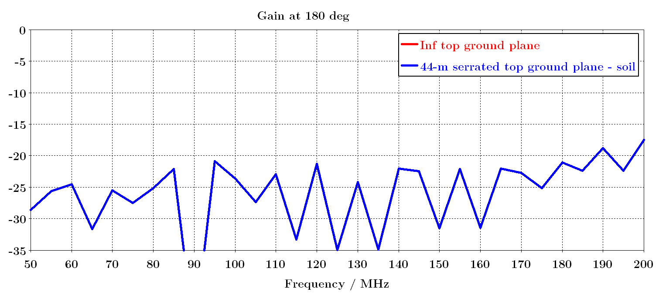
Gain (dB) at zenith and at 180°

Slide 24
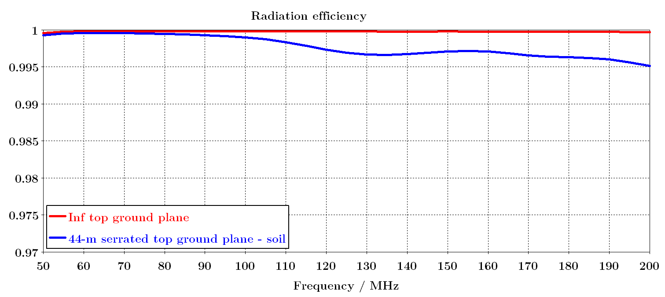
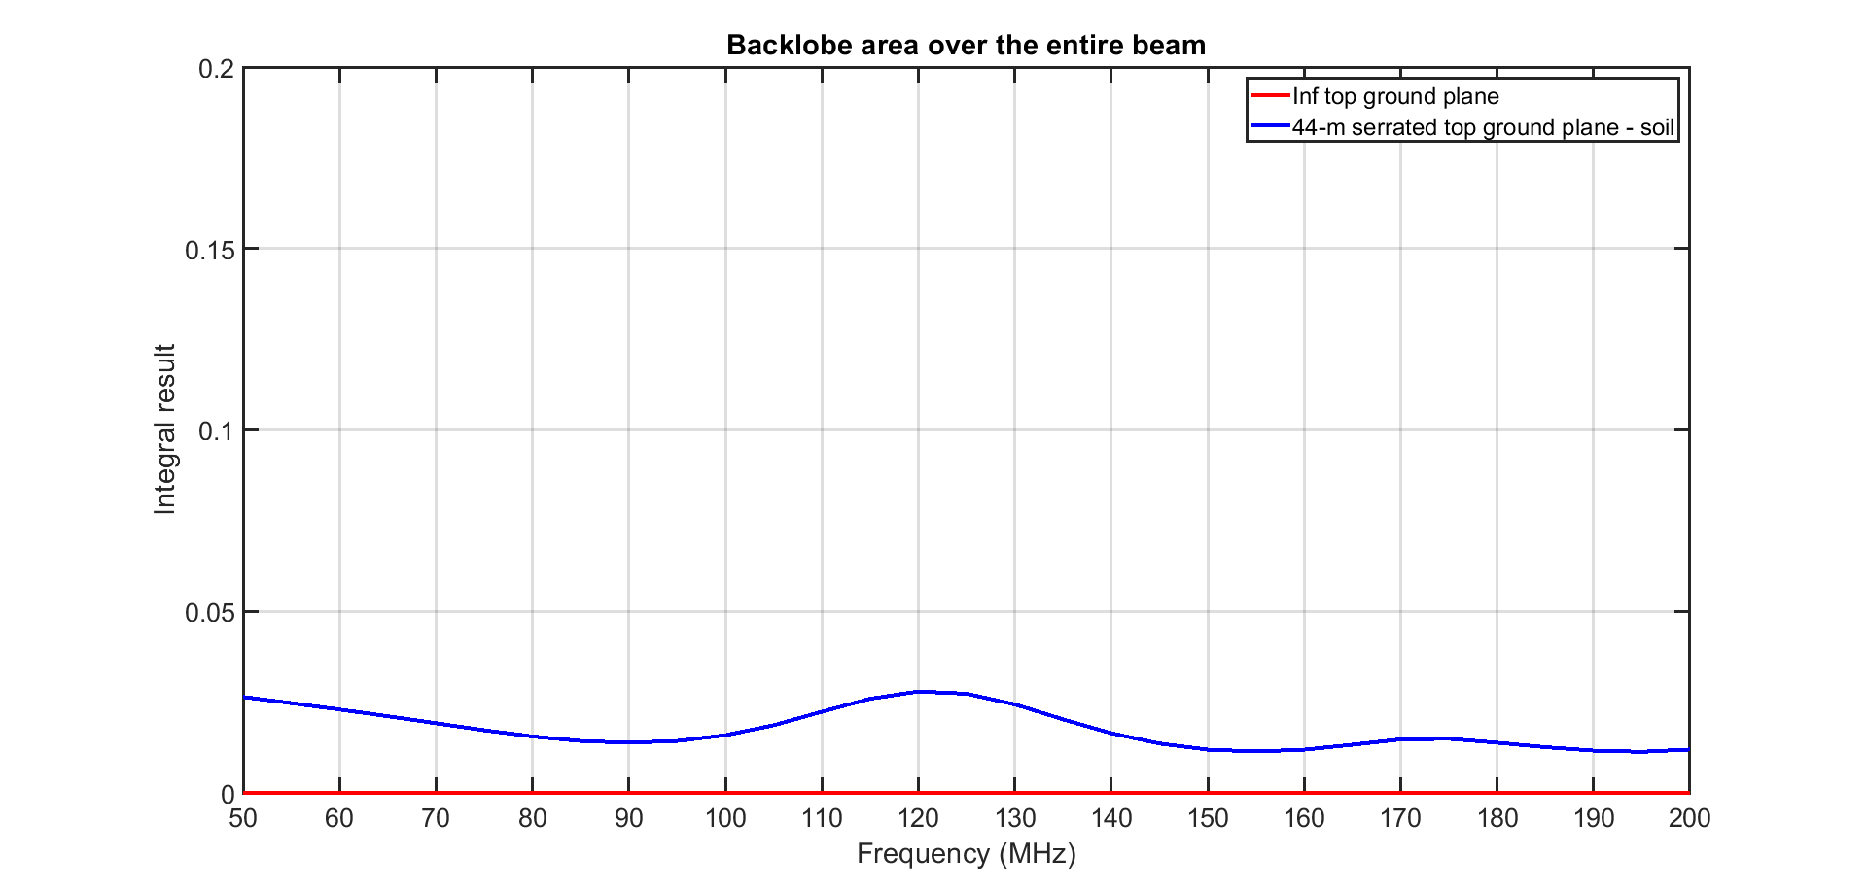
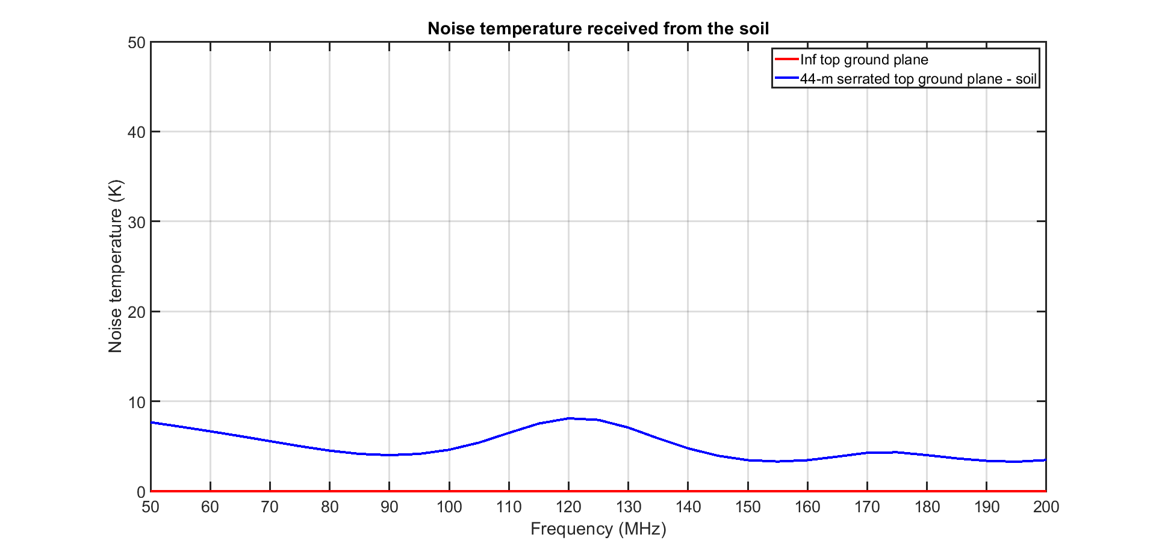
Radiation efficiency and backlobe area
Tsoil = 290 K

Slide 25




Gain patterns – E-plane

Slide 26




Gain patterns – H-plane

Slide 27


Chromaticity

Slide 28




Antenna temperature with sky model

Slide 29




Max absolute directivity error

Slide 30




Mean absolute directivity error

Slide 31




Max relative directivity error

Slide 32




Mean relative directivity error

Slide 33
Performance with BOTTOM ground plane

Slide 34

Bottom ground plane

Slide 35


Antenna impedance

Slide 36


S11 – with respect to 50 ohm differential

Slide 37


Gain (dB) at zenith and at 180°

Slide 38



Radiation efficiency and backlobe area
Tsoil = 290 K

Slide 39




Gain patterns – E-plane

Slide 40




Gain patterns – H-plane

Slide 41


Chromaticity

Slide 42




Antenna temperature with sky model

Slide 43



Max absolute directivity error

Slide 44



Mean absolute directivity error

Slide 45



Max relative directivity error

Slide 46



Mean relative directivity error

Slide 47
Summary of the performance

Slide 48
Summary of the performance (1)
 | No ground plane + soil | 5-m bottom ground plane + soil | 44-m top ground plane with serrations + soil
Antenna impedance | - Smooth - Optimised between 60 – 170 MHz - The ground plane / soil do not modify the antenna impedance
S11 (50 ohm) | - S11 < -5 dB between 55 – 200 MHz - S11 < -10 dB between 60 – 170 MHz - S11 < -12 dB between 81 – 161 MHz - S11 < -15 dB between 87 – 135 MHz
Gain at zenith | 6 – 13.5 dB Lot of small ripples | 5 – 14 dB Large ripples | 7 – 13 dB Smooth
Gain at 180° | < -6 dB | < -10 dB | < -20 dB
Beam | - Main beam relatively smooth up to 60° - Sidelobes with a lot of structures - Rather high backlobes | - Main beam relatively smooth - Sidelobes with a lot of structures - Moderate backlobes | - Main beam smooth - Moderate ripples on sidelobes - Low backlobes

Slide 49
Summary of the performance (2)
 | No ground plane + soil | 5-m bottom ground plane + soil | 44-m top ground plane with serrations + soil
Radiation efficiency | ~ 98% - Variations | ~ 98% - Variations | ~ 99.5% - Stable
Backlobe area ratio | 3 – 11 % - Variations | 3 – 9 % - Variations | ~ 2% - Rather stable
Soil noise temperature received by the backlobes | 7 – 31 K | 7 – 25 K | ~ 7 K
Chromaticity FoM | TOP ground plane (best) < NO ground plane < BOT ground plane (worst)
T_{ant} absolute error | TOP ground plane (best) < NO ground plane < BOT ground plane (worst)
Max absolute directivity error | TOP ground plane (best) < NO ground plane < BOT ground plane (worst)
Mean absolute directivity error | TOP ground plane (best) < NO ground plane < BOT ground plane (worst)
Max relative directivity error | TOP ground plane (best) < NO ground plane < BOT ground plane (worst)
Mean relative directivity error | TOP ground plane (best) ~ NO ground plane < BOT ground plane (worst)

Slide 50
Conclusions

Slide 51
Conclusions (1)
Design with the 44-m top ground plane with serrations provides the best performance for all the investigated FoM
+ Beam rather smooth considering the finite ground plane and the soil
+ Very low and stable backlobes
+ Smooth gain at zenith
+ Little affected by the presence of the soil
+ Wideband (optimised in the 80 – 160 MHz band)
+ Smooth antenna impedance
Challenging mechanical aspects
Large antenna (3.75 x 3.5 m), but the geometry is not too complex (imo)
To be buried into the ground
Very large ground plane
Complicated to move and try different locations
The alternative designs are easier to build and install, but significantly suffer from the effects of the soil and ground plane

Slide 52

Conclusions (2)
Trade-off
Adjust the thickness of the blades, the size of the circular stub, and the gap between the blades to tune the impedance and so S11, e.g.:
If better perf required at low freq => bigger antenna (~4 – 4.5 m)
Increasing the size of the ground plane decreases the beam chromaticity (trade-off between perf and construction constraints)
Feeding
Electronics inside the 50-cm thick blades
50-ohm coax cable?

